Slide 1
Chemistry Unit III
Energy and States of Matter
Temperature Curves
Specific Heat
Energy Calculations
Grimes Chemistry

Slide 2
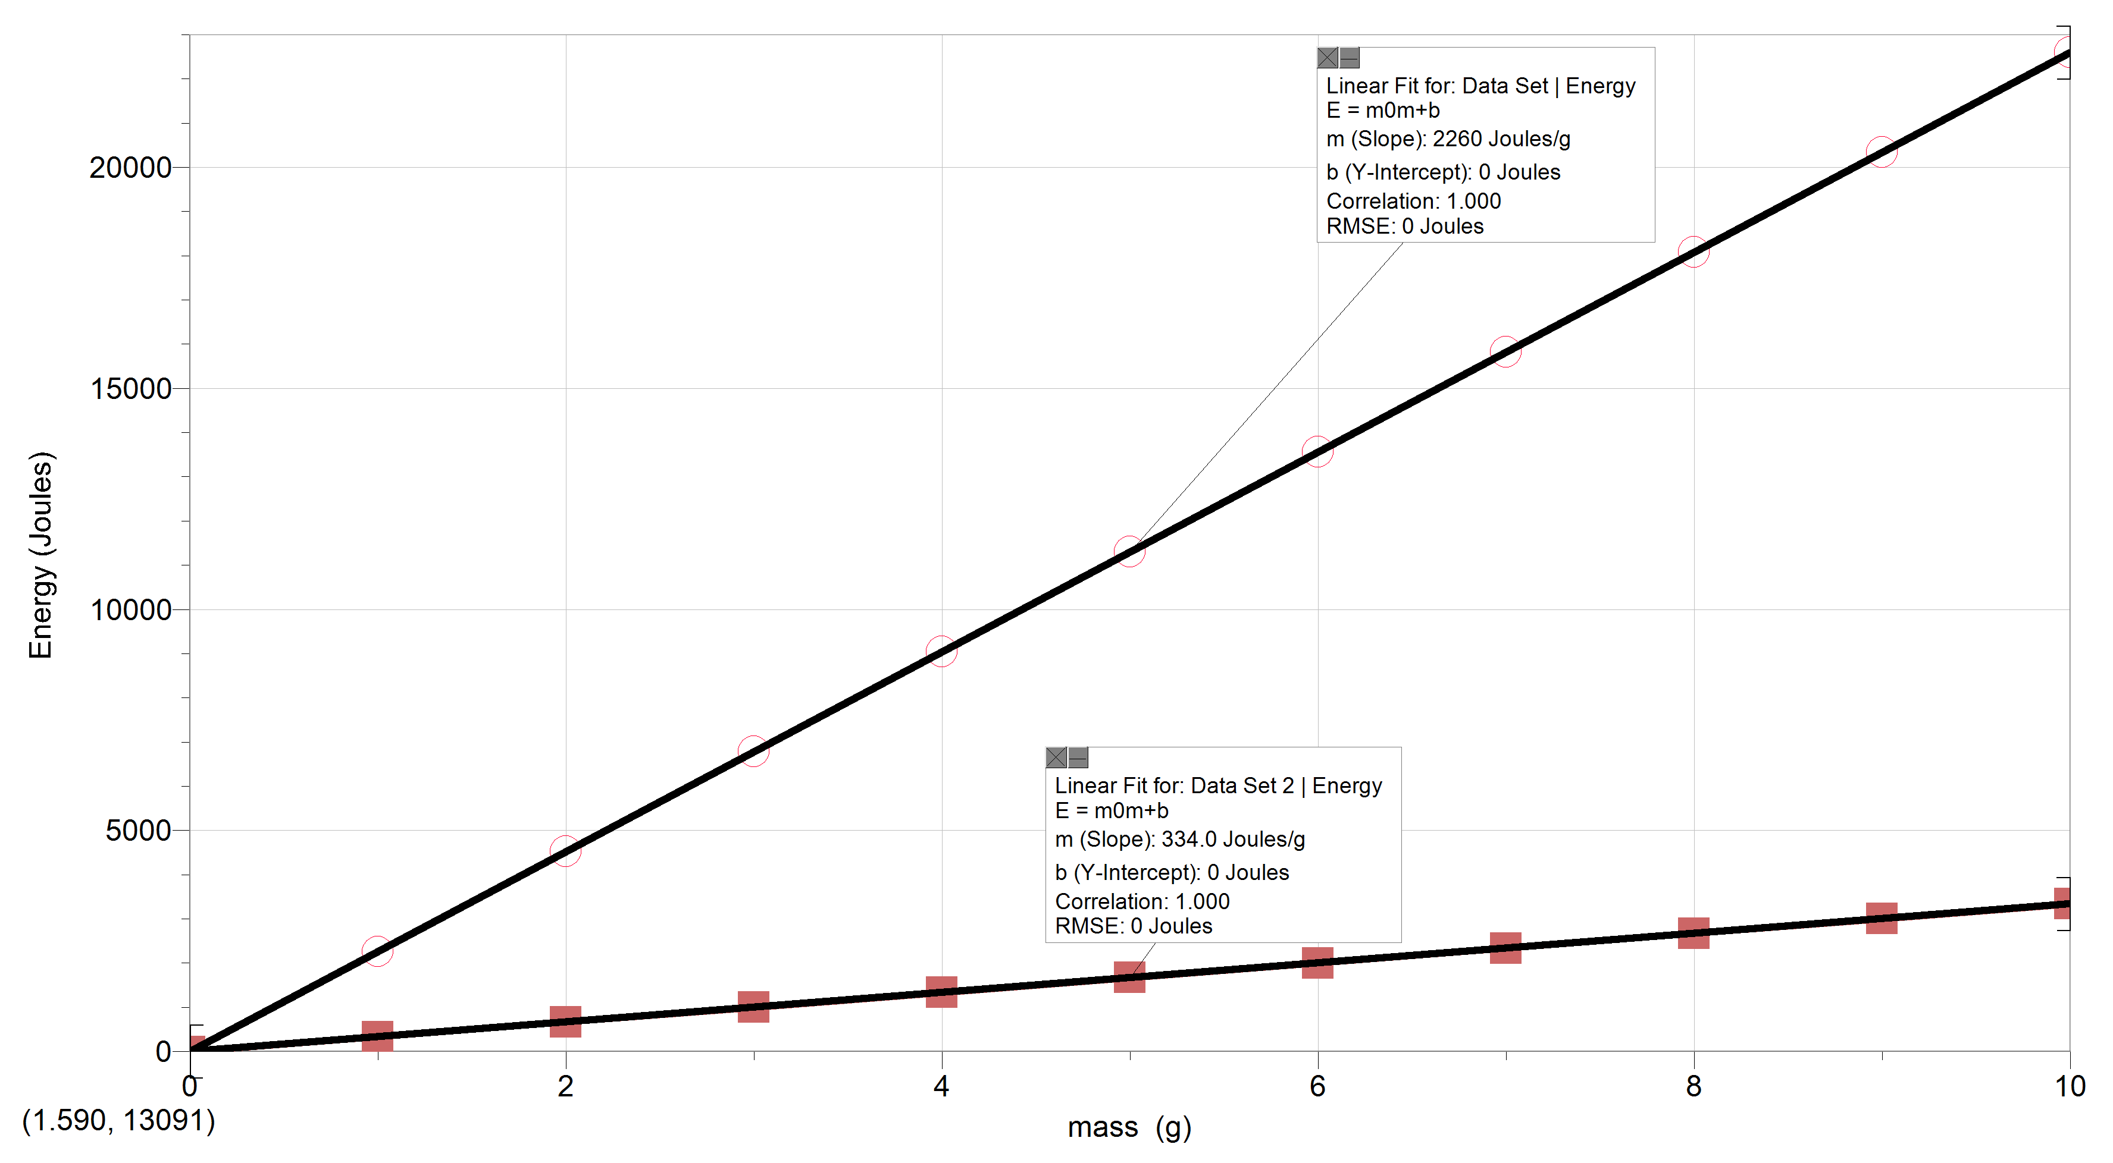
Phase Energies
Heat of Vaporization (H_{v})
liquid to vapor or vapor to liquid
2260 J/g
Heat of Fusion (H_{f})
solid to liquid or liquid to solid
334 J/g
Grimes Chemistry

Slide 3
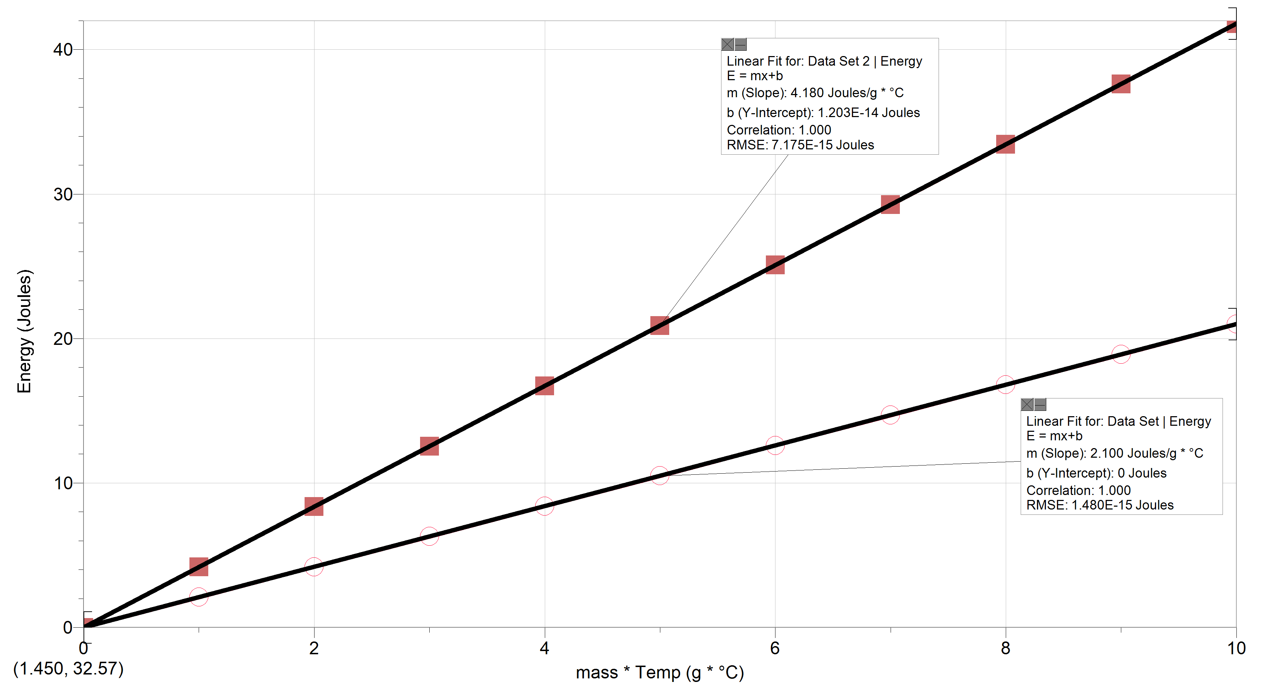
Heat Capacities (c)
Liquid water
Raising or lowering the temperature
4.18 J/g*°C
Solid water
Raising or lowering the temperature
2.1 J/g*°C
Grimes Chemistry

Slide 4
Energy Equations
Phase change: E_{(J)} = H_{(f,v)} x m_{(g)}
Temperature change: E_{(J)} = c_{(s,l)} x m_{(g)} x Δ°C
Notice when there is a phase change, change in temperature is not part of the equation.
Grimes Chemistry

Slide 5
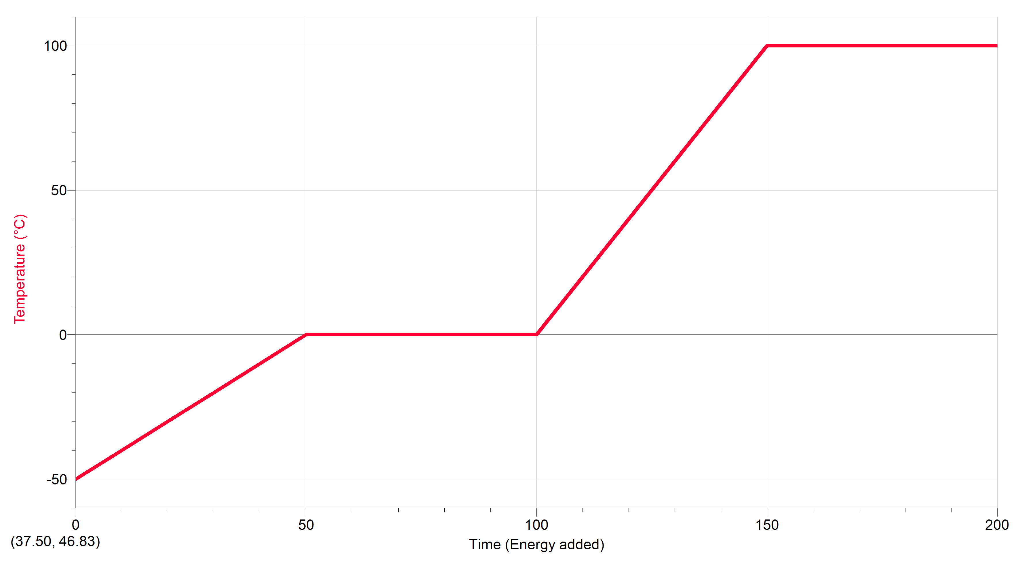
2260 J/g
Water
Energy Absorbed
vs
Temperature
E_{(J)} = H_{(v)} x m_{(g)}
4.18 J/g*°C
E_{(J)} = c_{(l)} x m_{(g)} x Δ°C
334 J/g
E_{(J)} = H_{(f)} x m_{(g)}
2.1 J/g*°C
E_{(J)} = c_{(s)} x m_{(g)} x Δ°C
Grimes Chemistry

Slide 6
How much energy is required to raise the temperature of 25°C water to 60°C?
1. Draw the water temperature graph.
2. Mark on the graph the location where the temp-erature change or phase change is taking place.
Grimes Chemistry

Slide 7
How much energy is required to raise the temperature of 25°C water to 60°C?
3. Choose and write the appropriate equation.
4. Rewrite the equation with the appropriate values inserted.
5. Solve
Grimes Chemistry

